Slide 1
Melbourne House Prices
Updated from January 2016
https://www.kaggle.com/anthonypino/melbourne-housing-market

Slide 2
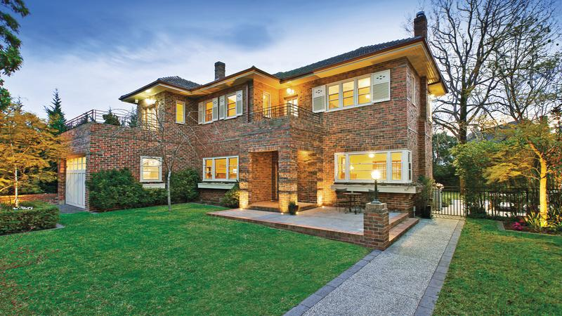

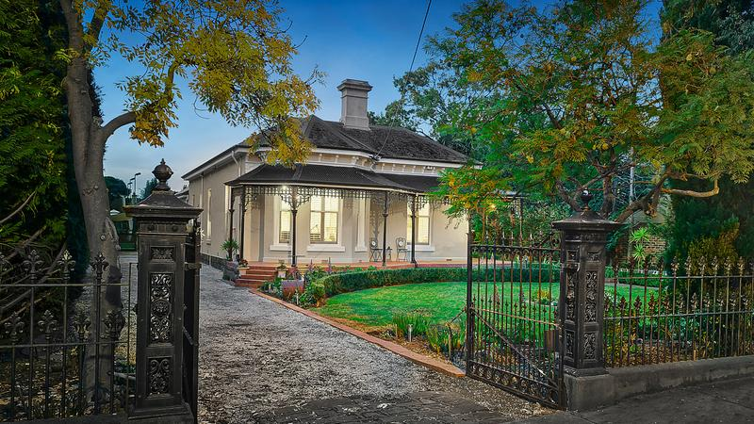
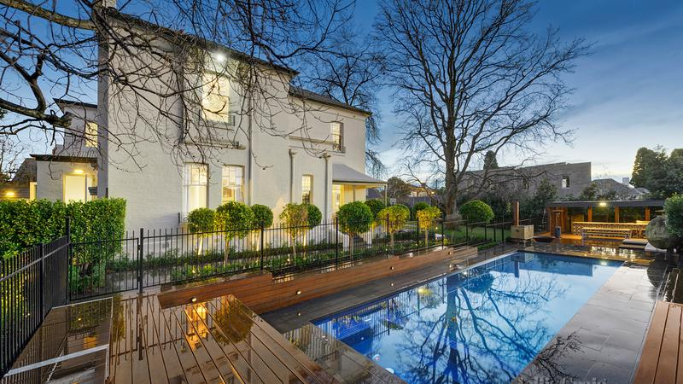
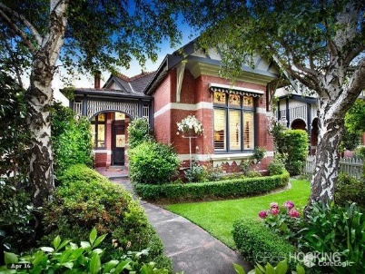
Agenda
$8M
Introduction to our dataset
Question Discussions:
Probability
Pareto Analysis
Chi Squared
ANOVA
Regression
Forecast
$7.65M
$6.5M
$6.4M

Slide 3
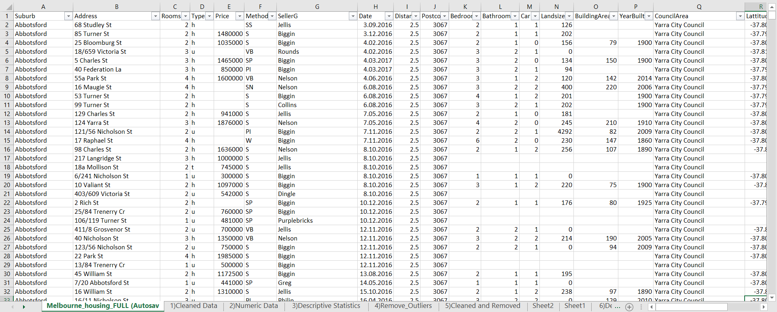
Introduction to dataset
34,858 records
21 Variables
Notes:
This data is about Melbourne housing prices updated from January 2016.It contains 21 variables( including address, rooms, type, price, method, Seller G, date, distance, postcode, bedroom2, bathroom, car, landsize, building area, year built, council area, latitude, longitude, region name and property count), and has sample size of 34,858 records. We have decided to analyze Melbourne_housing_FULL data.

Slide 4
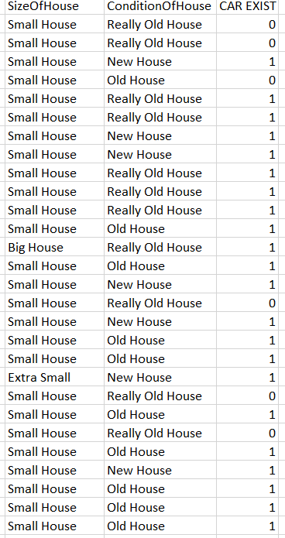
Categories
Size of House
<1910 - Really Old House
1910< House <2000 - Old House
2000< House< ... - New House
Condition Of House
Less than 2 Rooms - Extra Small
Between 2 - 3 Rooms - Small House
More Than 4 Rooms and 2 Bathroom - Big House

Slide 5
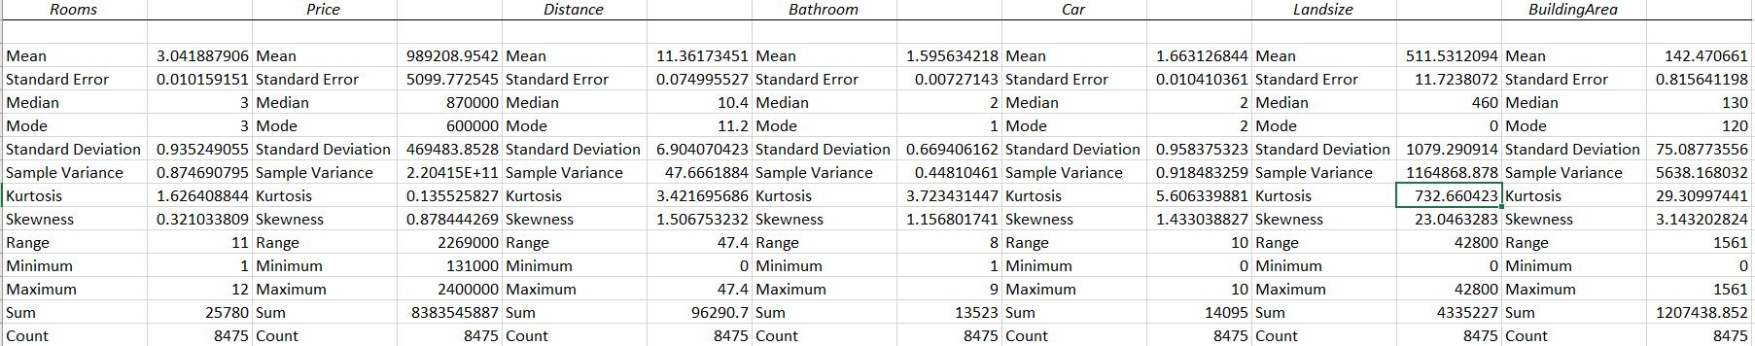





Descriptive Statistics
Price Room Bathroom Car
Max $9,000,000 12 9 10
8475 records
Mean 989,208.95 3.04 1.59 1.66
24 Variables
Min $131,000 1 1 0
Notes:
We analyzed skewness and kurtosis and decided to check the outliers for price, landsize and building area. The outlier function is located in “numeric data” tab.
After finding the outlier we removed the outliers from datasets which is now located in “cleaned and removed” tab.
We created new “Descriptive statistics 2” tab and we saw that the amount of skewness and kurtosis decreased slightly. So price variable has normal distribution.

Slide 6
Probability
1 2 3 4 More than 5 rooms

Slide 7
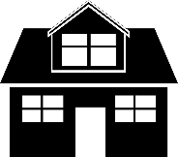

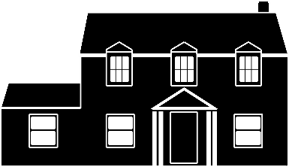
1. Probability
A construction company signs a contract to build houses based on room preferences. Therefore, what will be their maximum probability for no. of rooms?
The
Percentage
Type of
House
%17
%8
%75
Average
Number
Of Rooms
1.96
2.87
3.39
probability
No. of Rooms | Really Old House | Old House | New House | Change of Percentage
1 room | 2% | 4% | 5% | +3%
2 room | 33% | 21% | 25% | -8%
3 room | 45% | 47% | 38% | -7%
4 room | 18% | 23% | 28% | +10%
more than 5 rooms | 2% | 6% | 5% | +3%
Total | 100% | 100% | 100%
Duplex
Townhouse
Villa
Notes:
We created a pivot table based on no. of rooms and condition of houses(New house, Old house, Really old house).
For an instance, if a family is looking for a 3 bedroom house which has a very good condition and seems new (therefore, 38% is the available probability)
The chart also displays if someone wants to buy a house with more than 5 rooms. According to these numbers, we can say that there are just 5 percent new houses that has more than 5 rooms.

Slide 8
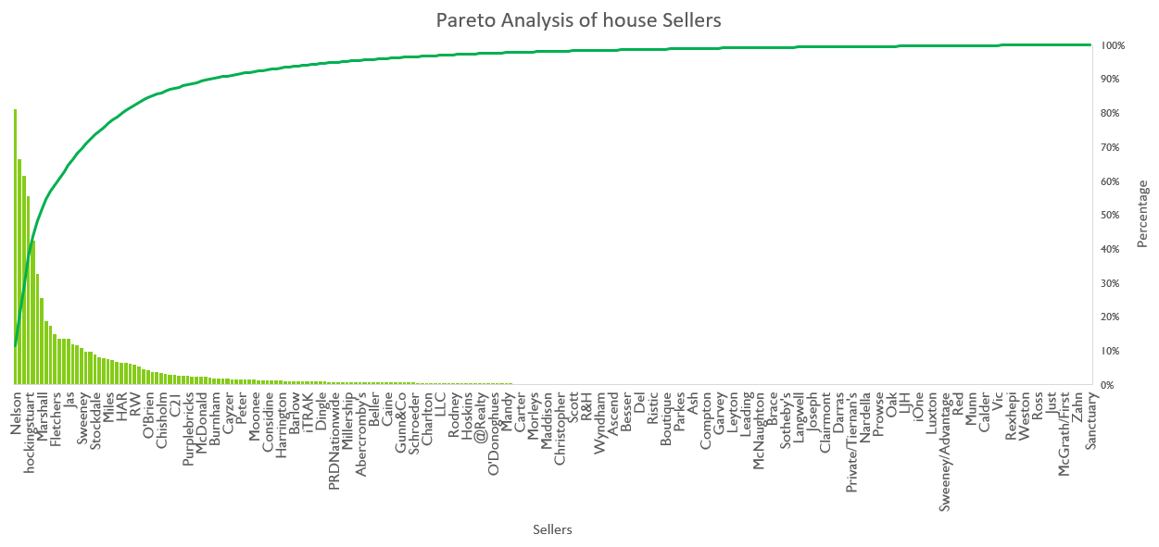
2. Pareto Analysis: Who is the best house seller in Melbourne?
Notes:
As per pareto 80-20 rule, around 20% of sellers put efforts to sell houses but rest of the sellers need to produce income out of their businesses.

Slide 9
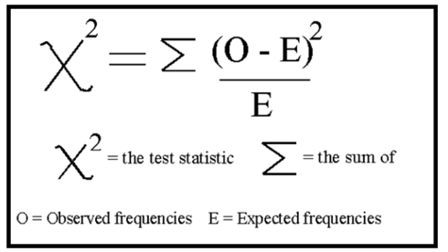
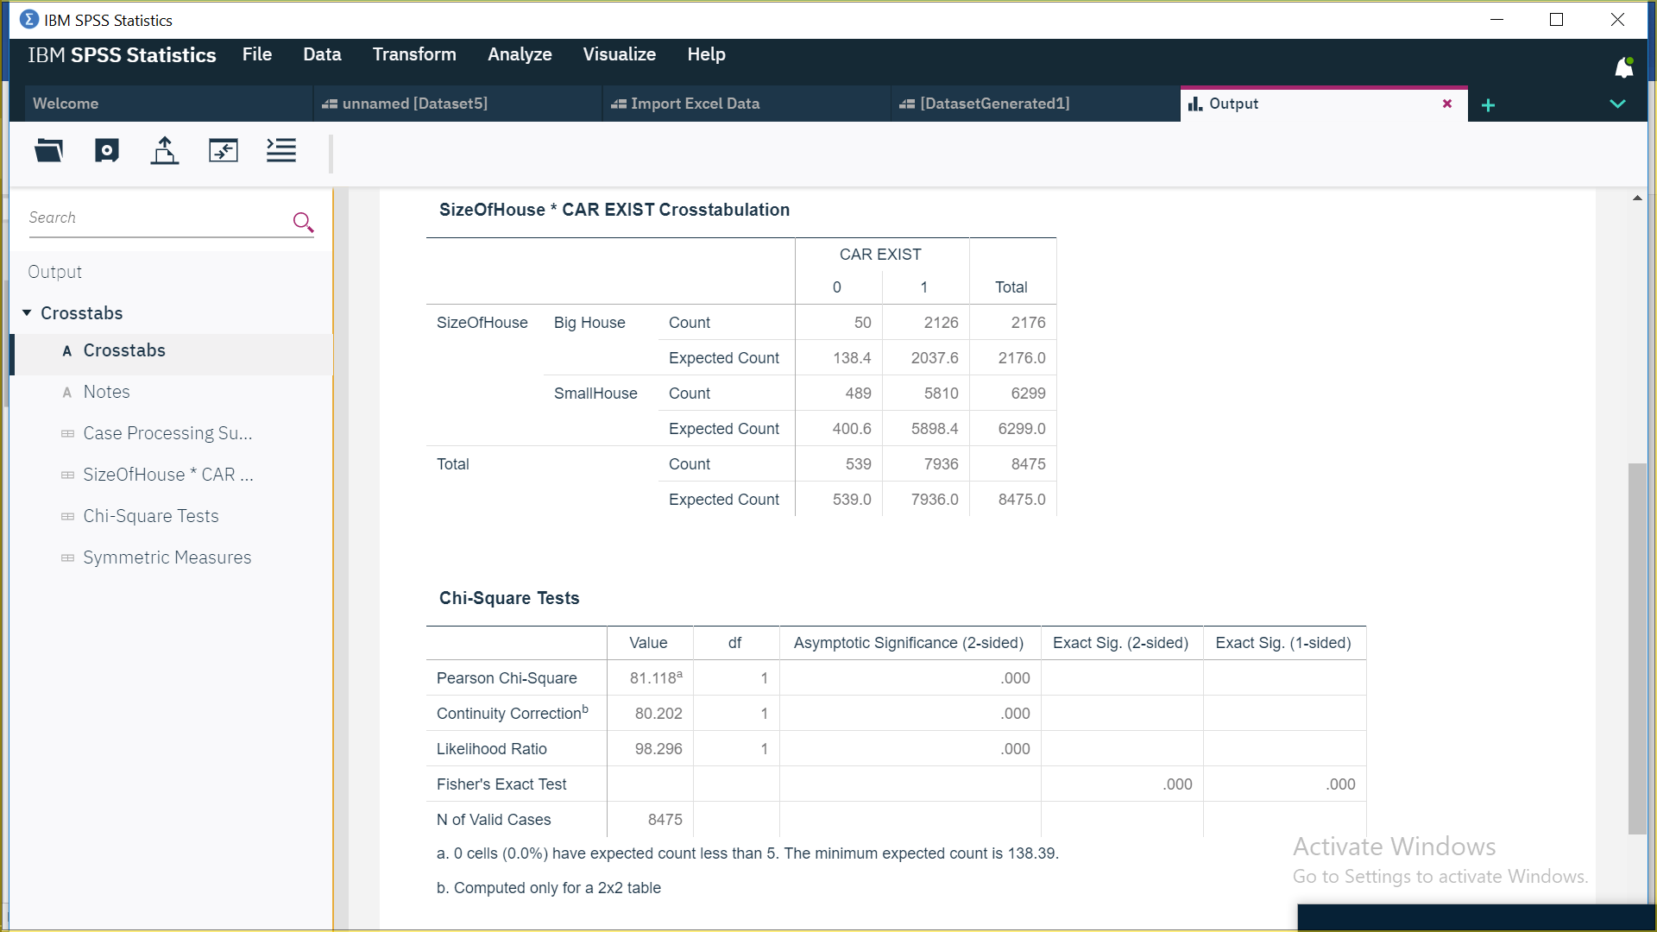
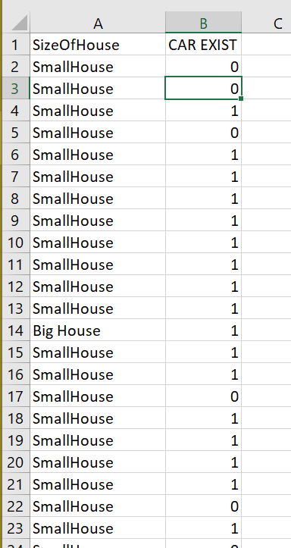
3. Chi-Squared Test
Notes:
Statistical Package for the Social Sciences
Significance… correlation between car and house.
Based on observed and expected data the following Chi² is created.
Our Chi Square value is 81.1 and Our degrees of freedom value is (2-1)*(2-1)
and in terms of df, our table chi square value is 3.84. Hence, we can say that the variables have a statistically significant association.

Slide 10
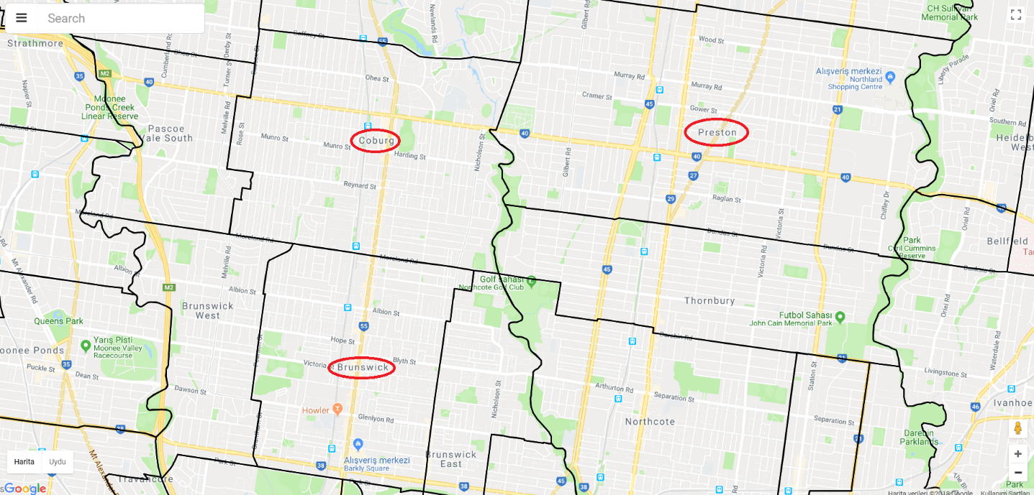
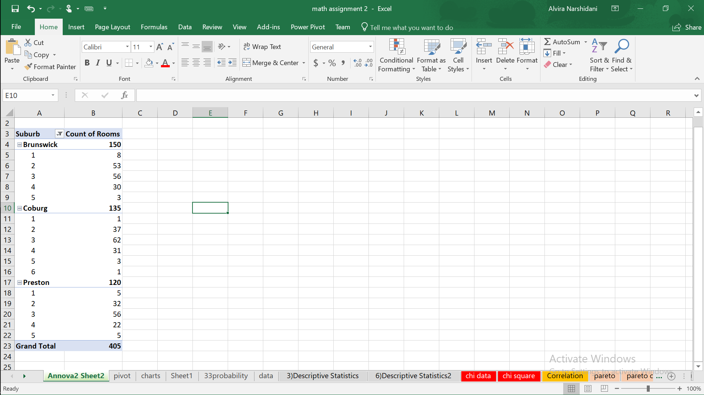
4. ANOVA(ANalysis Of VAraince)
Notes:
For anova test, we choose to 3 different suburbs where are located in downtown of Melbourne and are close each others. In this test, we try to find that is there difference between the houses that has 3 rooms.
As you can see below, we filtered our data and created pivot table. Hence, we retrieve 165 (55 houses from each of them) different houses has 3 rooms from Brunswick, Coburg, and Preston

Slide 11
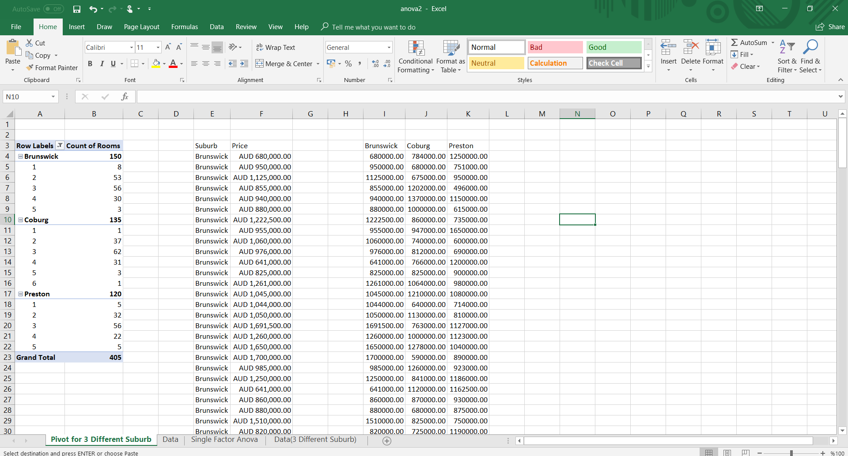
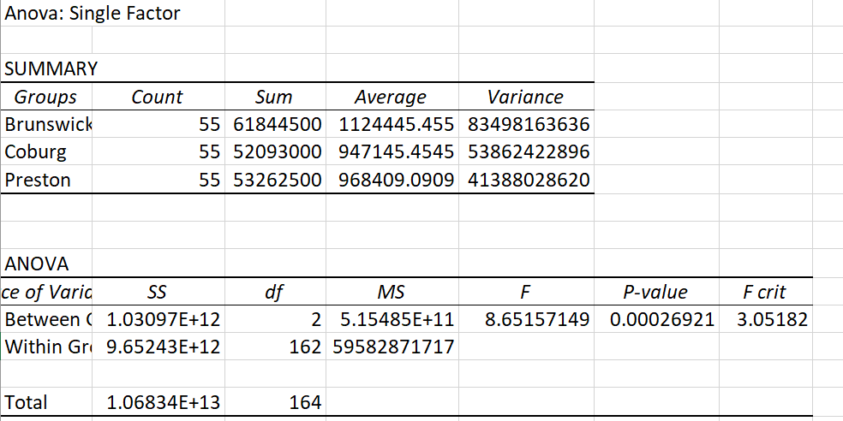
p value is less than 0.05, so we can say that the differences between houses are statistically significant. As well as our F value is 8.65 which is higher than F ratio for 2 degrees of freedom which is around 3.0
Notes:
As a result of our anova test, our p value is less than 0.05, so we can say that the differences between houses are statistically significant. As well as p value, our F value is 8.65 which is higher than F ratio for 2 degrees of freedom which is around 3.0

Slide 12
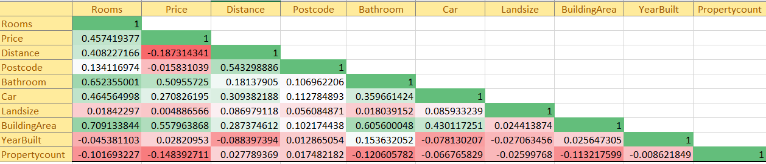
Correlation

Slide 13
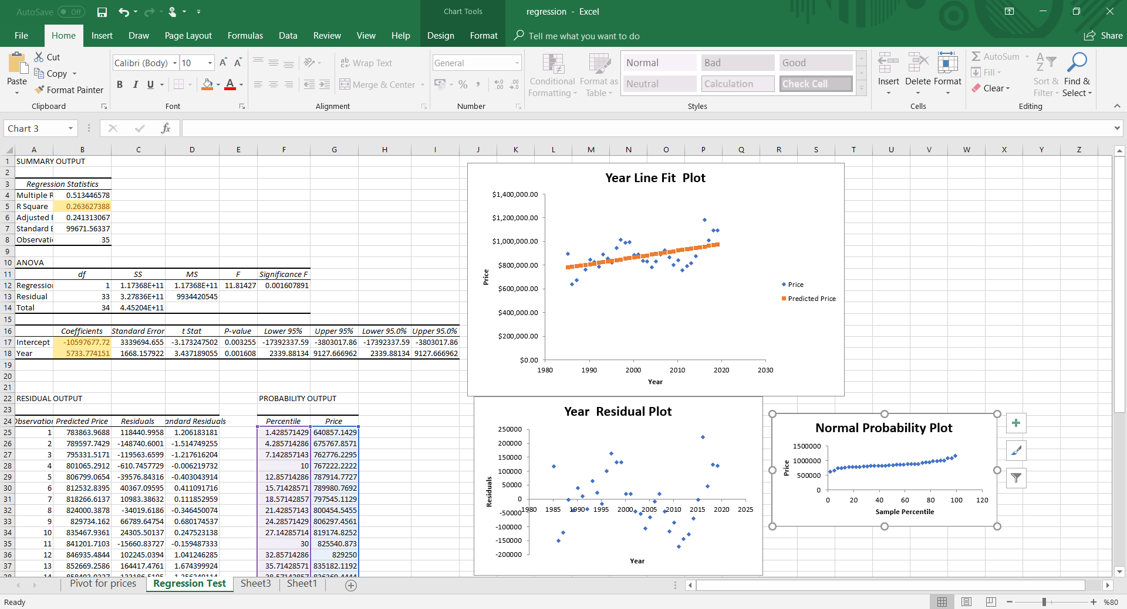
5. Regression
Notes:
For regression test, we created pivot table to find average of houses in terms of years. And then, we implement regression test to create our model. Hence, according to our test, the houses prices increase around 5,700 AUD every year, and our model is
(5733.77*x) -10597677.7

Slide 14
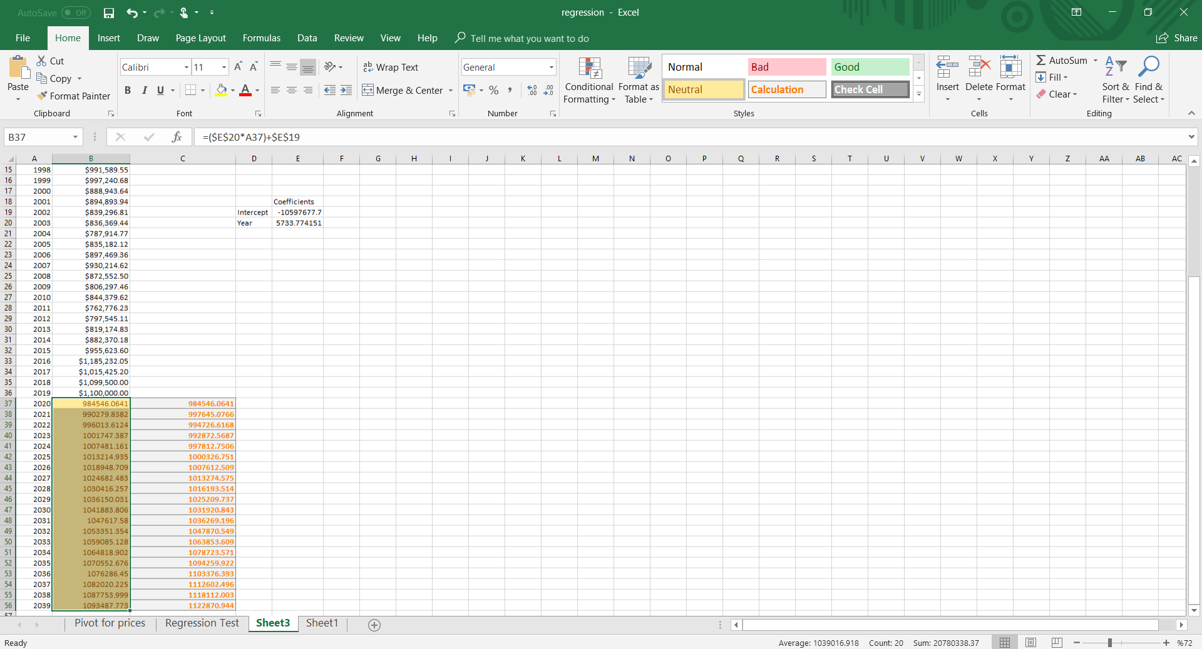
5. Forecast
Notes:
Thanks to our regression model, we forecast how much the average house prices will increase until 2039 in Melbourne.
In addition, we forecast the average house prices with excel forecast function.

Slide 15
References
www.google.com
www.youtube.com
www.ibm.com

Slide 16
Thank you

